Slide 1
Bayesian Optimisation for chemical reaction engineering
A data-driven way of exploring a mixed space
Ted Ladas, PhD Candidate at KCL | 20-Aug-2022

Slide 2
The main idea
- The aim of the internship: Explore Bayesian Optimisation in the field of Chemical Synthesis
- Many papers in the literature demonstrate how useful this algorithm can be
- The challenge is to include multi-level categorical features in the algorithm as well

Slide 3
Gaussian Process Regression
Weight all possible models

Slide 4
Gaussian Process Regression - basic idea
- Suppose we have the problem $f(x)=w^{⊤}x+ε$
- with data $D=\{(x_{1},y_{1}),(x_{2},y_{2}),…,(x_{n},y_{n})\}$
- We need $D→w→y^{new}$. The $w$ itself are not important
- What we really care about $P(y|x,D)=∫_{w}p(y|x,w)\frac{p(D|w)p(w)}{Z}dw$
- If we make the assumption that $p(w)∼N$ then $p(y|x,D)∼N(μ,Σ)$

Slide 5
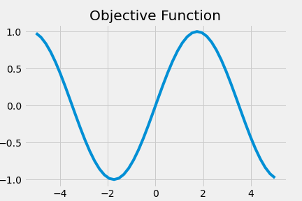
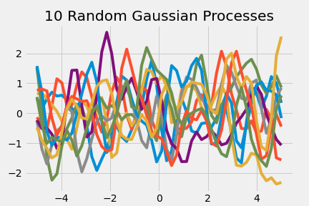
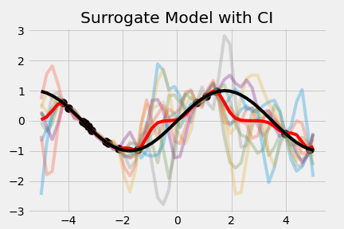
The Gaussian Process example
- We want to estimate the simple objective $f(x)=sin(x)$
- Assuming a Gaussian Prior we draw 10 Gaussian Processes
- Given some $x$ we can run the experiment and calculate $f(x)$
- With that data we can calculate $μ$ and $Σ$ of the posterior
$\overset{̂}{y}|D=N(K_{*}^{⊤}K^{-1}y,K_{**}-K_{*}^{⊤}K^{-1}K_{*})$, where $K$ some kernel

Slide 6
Bayesian Optimisation
A Sequential algorithm for optimisation

Slide 7
Bayesian Optimisation - basic idea
- Suppose we have the same black-box function $f(x)$
- Expensive Evaluation - Noise corrupted observations
- We don’t care anymore about $\overset{̂}{f}$ - We care about $\text{argmax}f(x)$
- We need a strategy to select $x^{next}$
1. Initial sample of input.
2. Evaluate the black box function $f(x)$
3. Train the Model - (Gaussian Process, Response Surface, Trees, Bayesian Neural Network, etc)
4. Calculate the acquisition function $α(x)$
5. Identify next step $\text{argmax}α(x)$
6. Goto step 2, until budget is exhausted

Slide 8
Bayesian Optimisation - basic idea
- The $α(x)$ balances exploration and exploitation.
- In a simple example $α(x)=f(x)+k⋅\text{sd}(f(x))$
- Small $k$ $→$ $α(x)≈f(x)$ $→$ Local Optimisation (exploitation)
- Large $k$ $→$ $α(x)≈\text{sd}(f(x))$ $→$ Global Optimisation (exploration)
- Then the query strategy is simply: $x_{next}=\text{query}(M,D)={\text{argmax}}_{x∈X}α(x;M,D)$

Slide 9
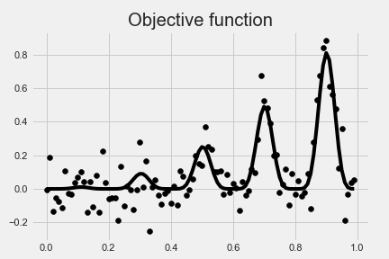
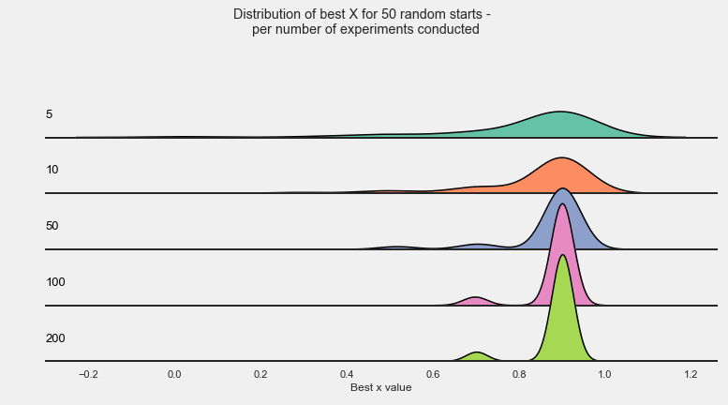
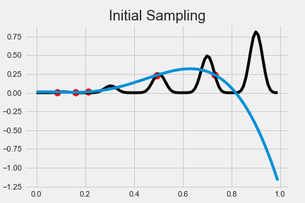
Bayesian Optimisation - example
- We have the objective $f(x)=x^{2}sin(5πx)^{6}$
- We obtain a random sample of $5$ input points

Slide 10
Demo
Web Application

Slide 11
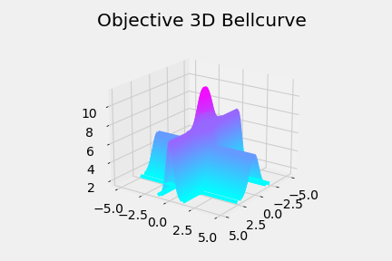
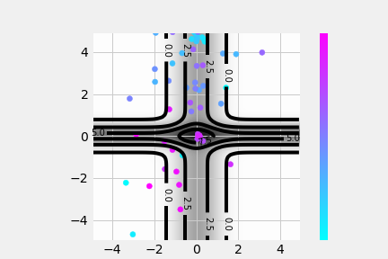
Bayesian Optimisation System
- 3d Example of a known function with steep local optima
- Objective $f(x_{1},x_{2})=4exp(-x_{1}^{2})+6exp(-4x_{2}^{2})maxf=f(0,0)=10$
- The algorithm start of randomly
- After 50 experiments it finds the global maximum

Slide 12
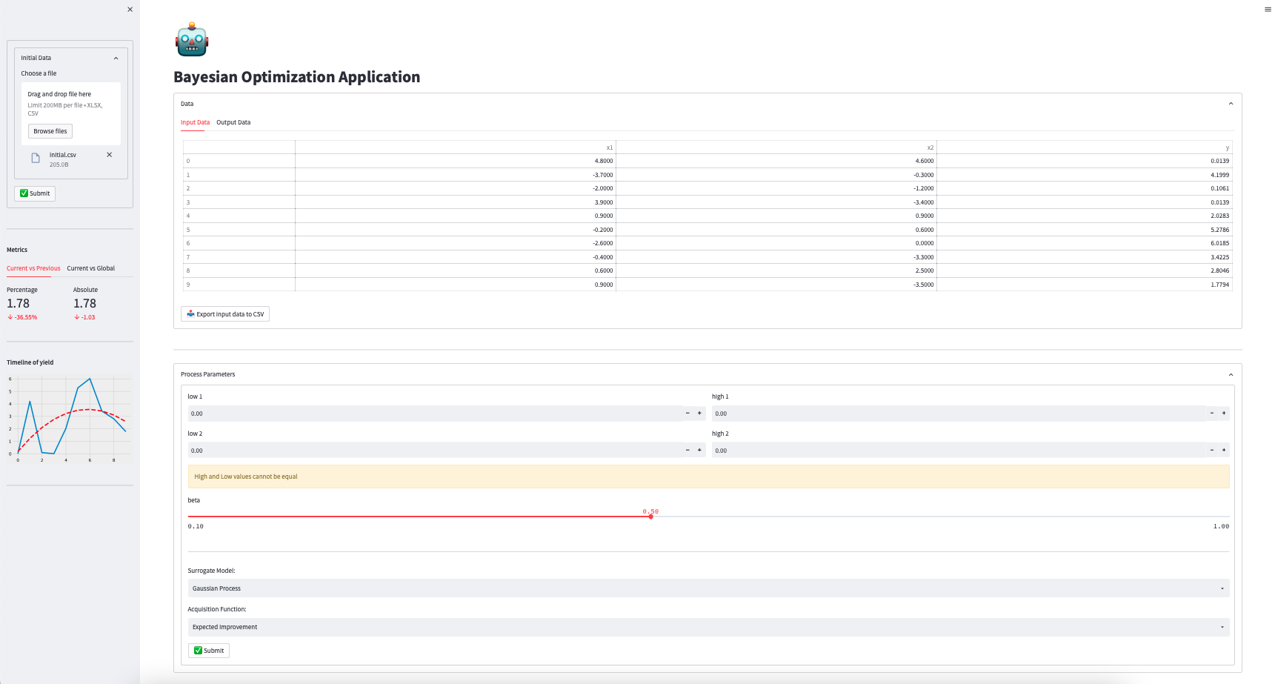

Slide 13
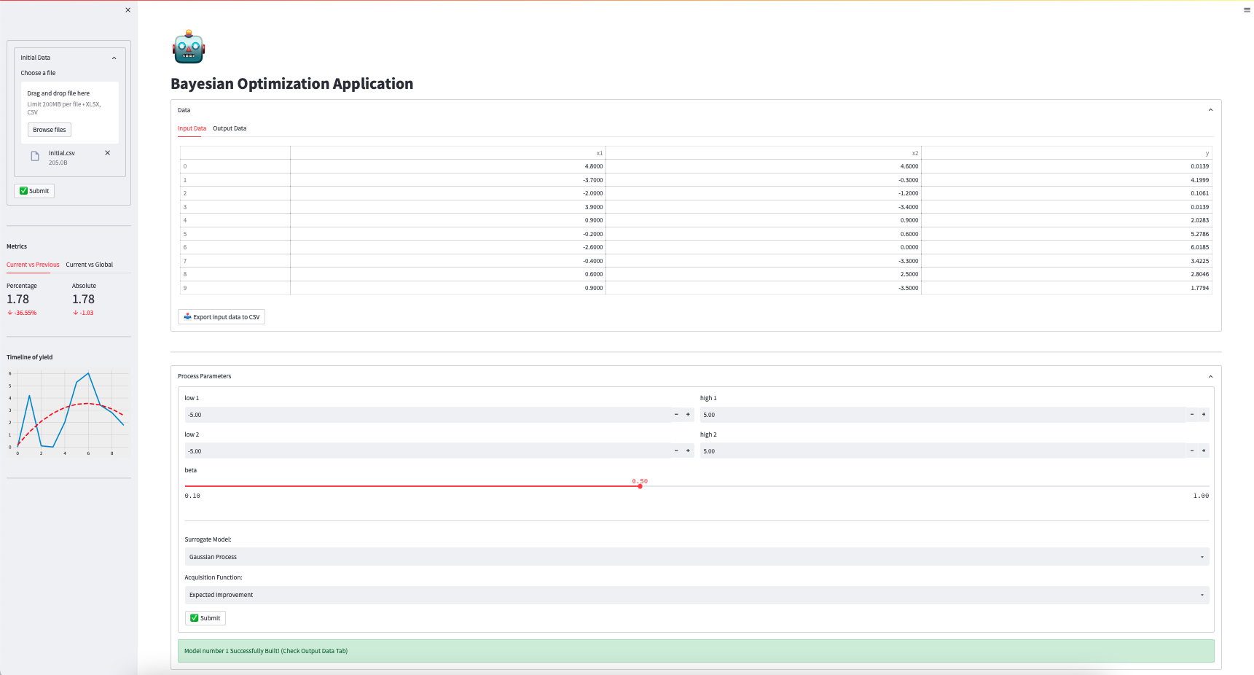

Slide 14
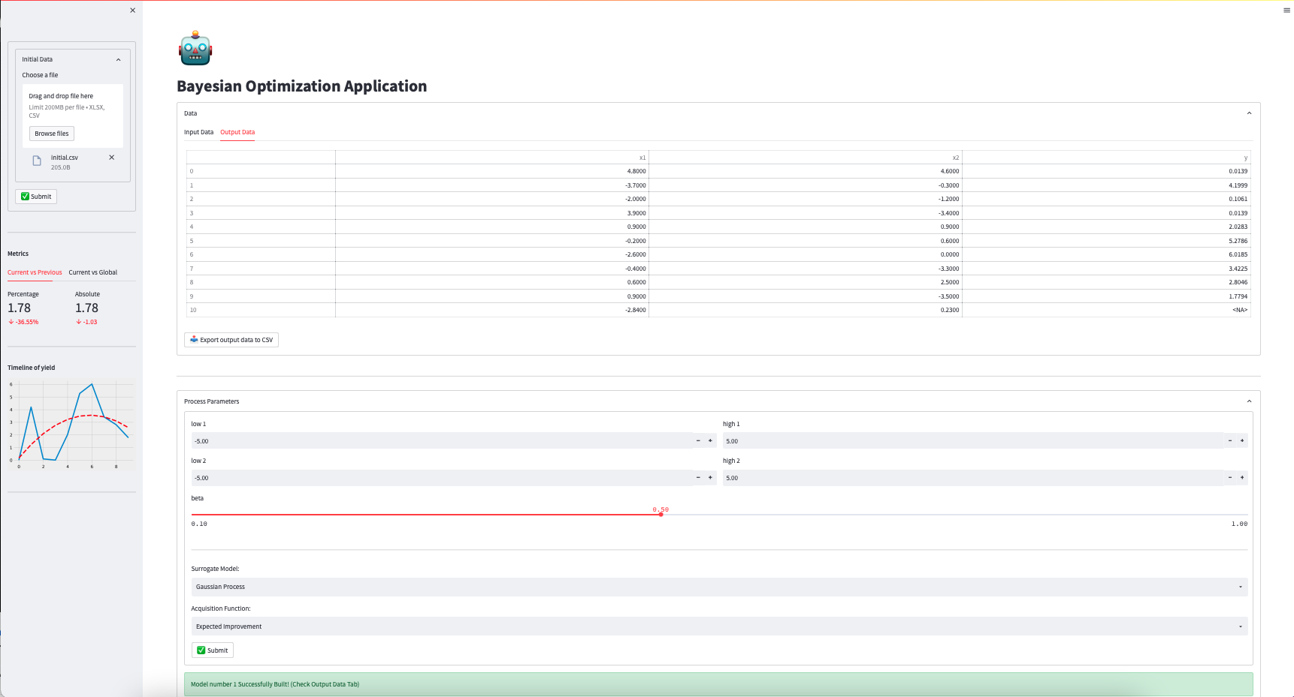

Slide 15
Categorical Variables
Domain knowledge

Slide 16
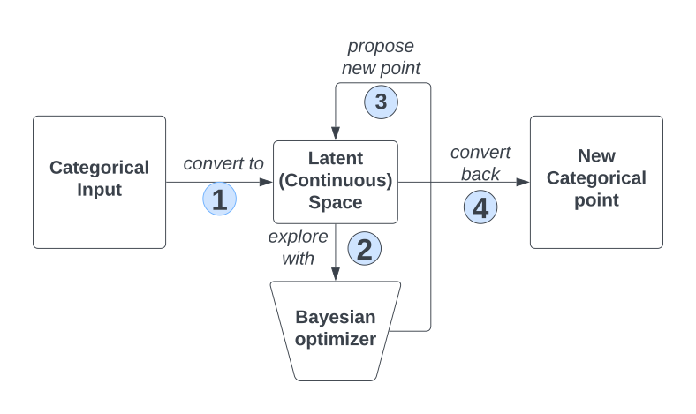
Chemical Descriptors
- Use chemical descriptors to measure distances on a latent space
- Molecular weight and quantitative estimation of drug-likeness
- Search on the latent space and translate back to
categorical space through distance measures

Slide 17
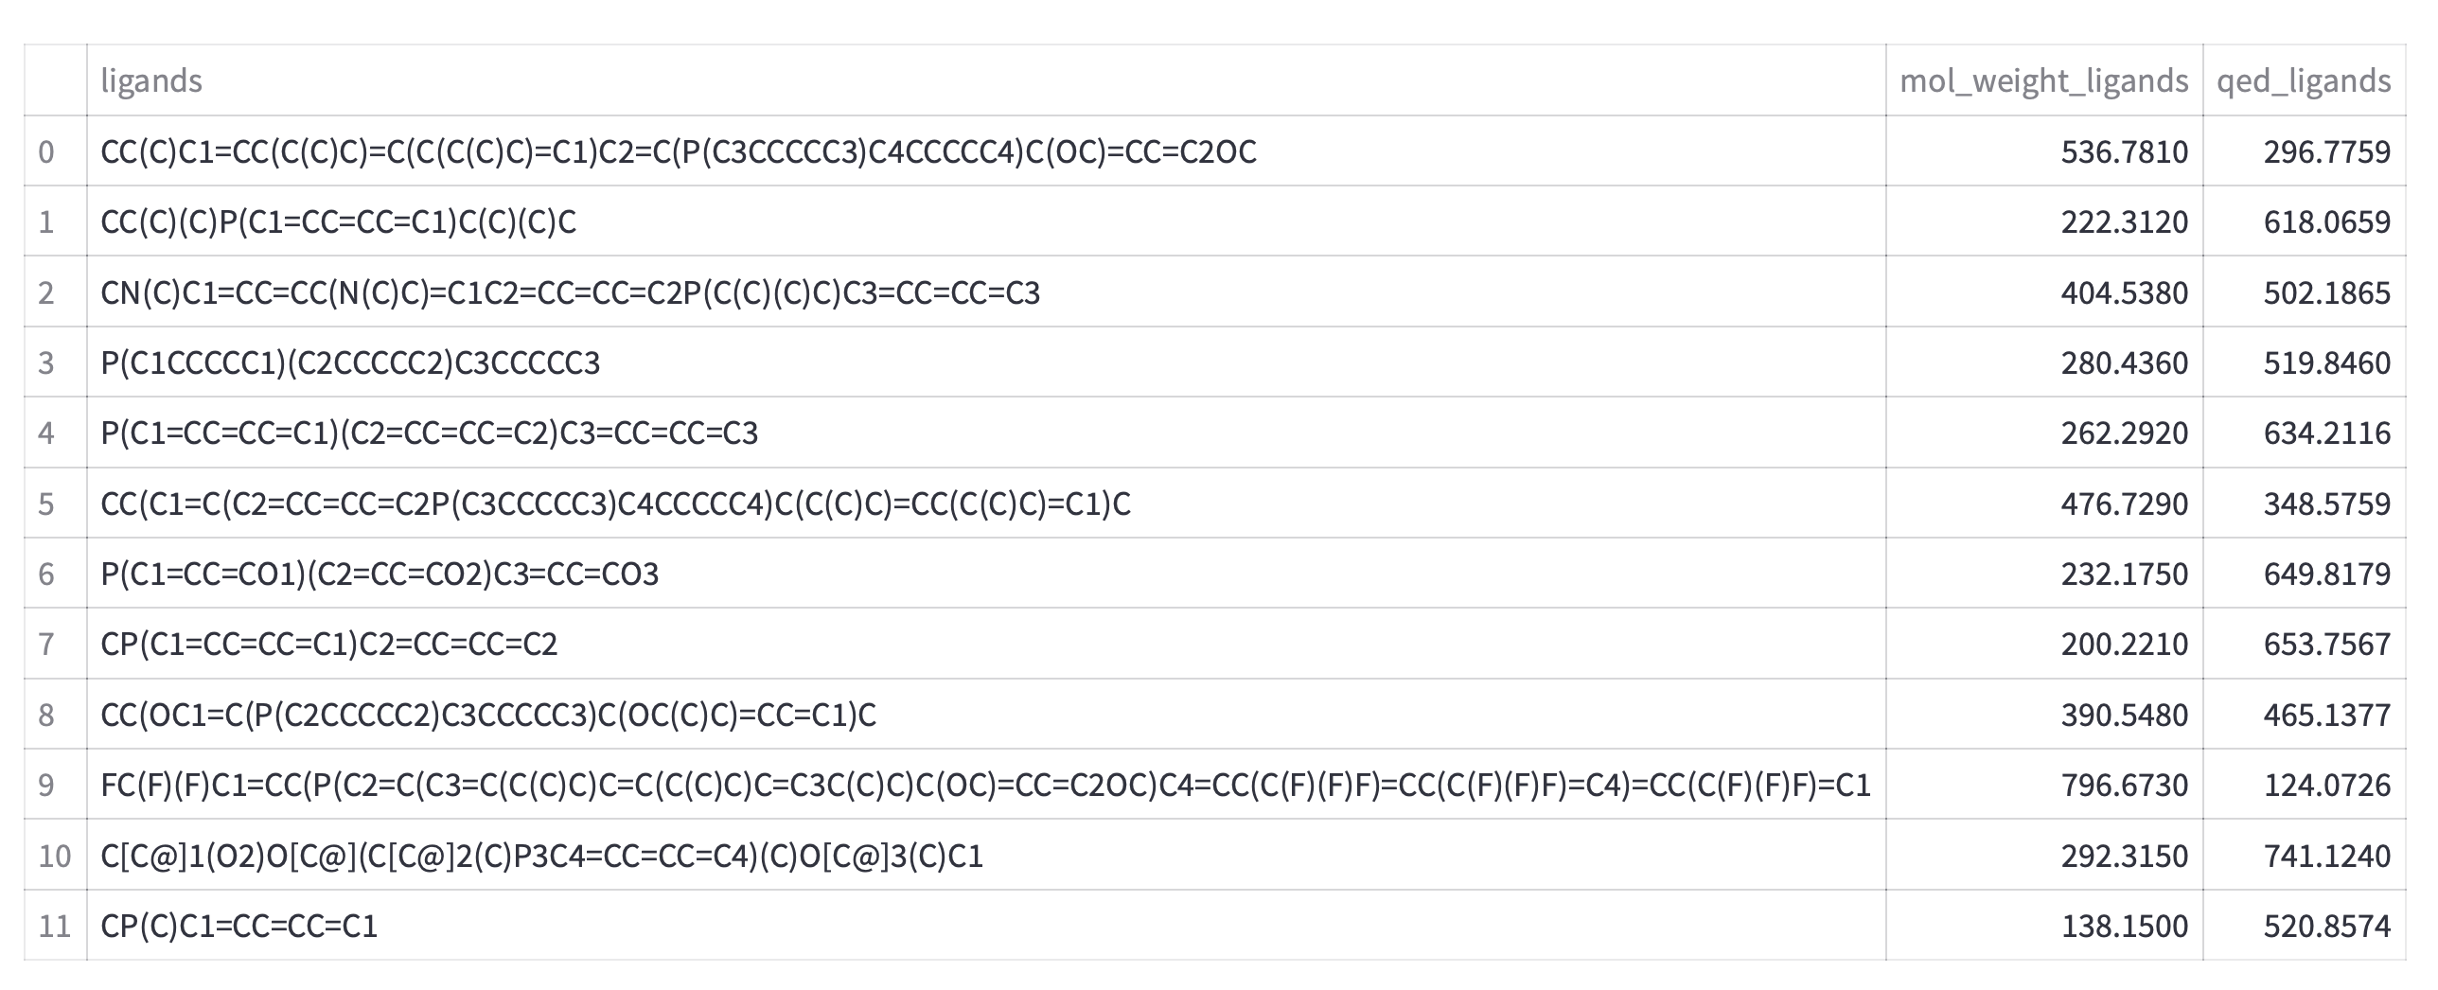
Chemical Descriptors

Slide 18
Categorical Variables
Data-Driven

Slide 19
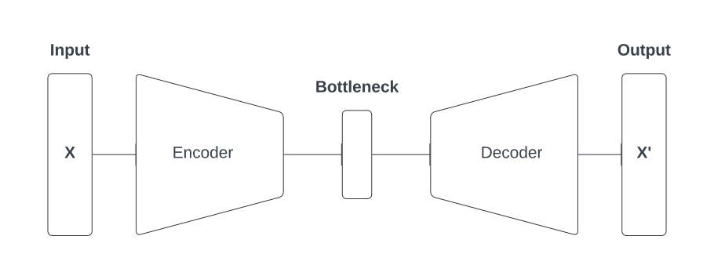
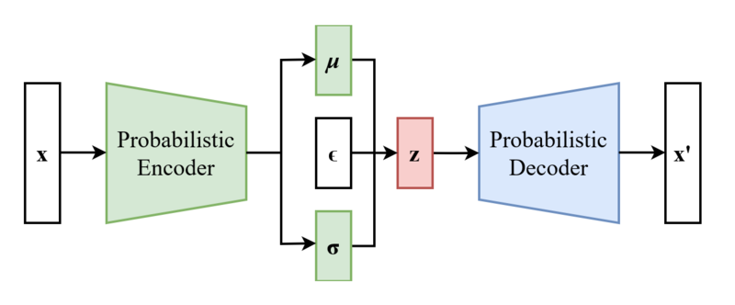
Variational Auto-Encoders
- Auto-encoders are Neural Network architectures
- The network is a function $f(x)≈x$
- A generalisation of auto-encoders are variational auto-encoders
- $z=μ+σ×ε,ε∼N(0,1)$, hence $z∼N(μ,σ^{2})$

Slide 20
Variational Auto-Encoders utility
- Bayesian Optimisation needs numerical inputs
- Learn a numeric latent representation of the categorical variables
- Perform a step in that space through Bayesian Optimisation
- Decode the new signal and run the experiment

Slide 21
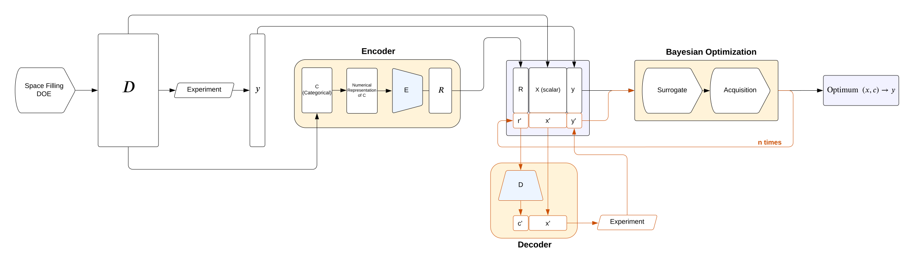
Bayesian Optimisation System

Slide 22
Thank you
tladas@its.jnj.com / k20103629@kcl.ac.uk
30-Aug-2022

